Slide 1
Progress report
Speaker: Geng-Yun Tien
Advisor: Eric Y. Chuang
Date: 2023/09/27

Slide 2
Works
1
Reshape the patch size into 512*512 pixel
2
Inception v3 model training script
3
Decide the Big lab meeting paper presentation
4
Teach how to download the image data from TCGA database

Slide 3


Download Whole Slides Image from TCGA database

Slide 4
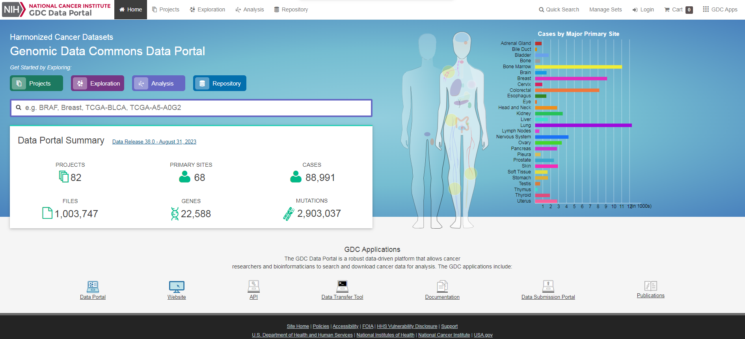
GDC data portal
https://portal.gdc.cancer.gov/

Slide 5
GDC data portal
1
Click the Repository button

Slide 6
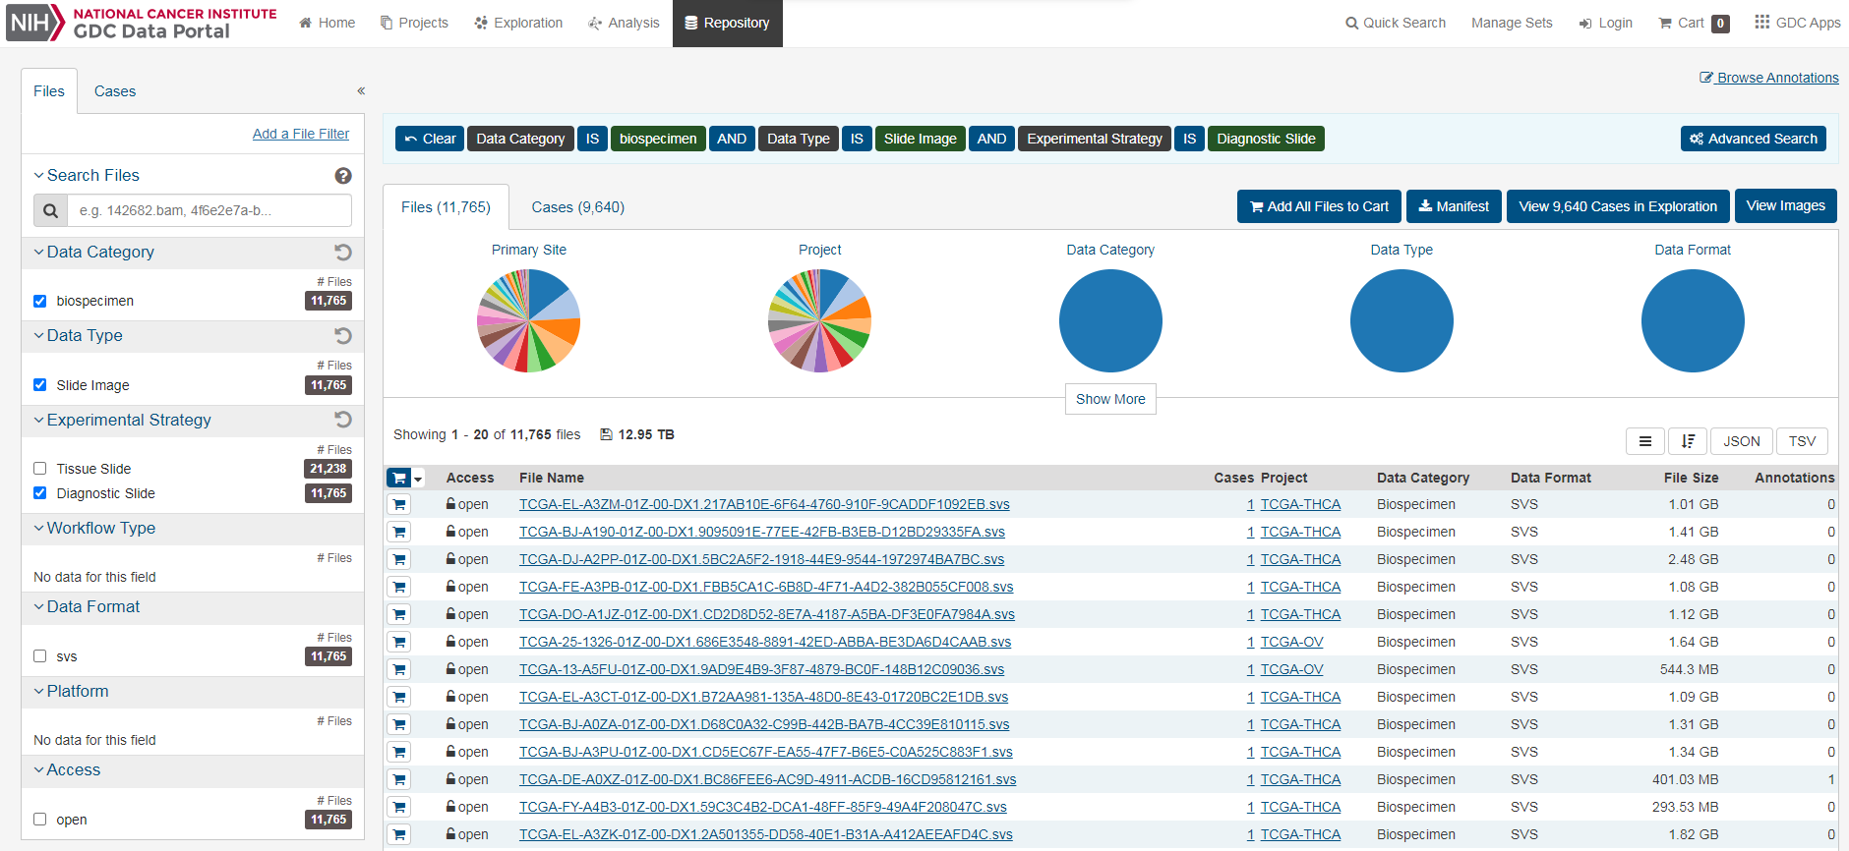
GDC data portal
2
Chose the biospecimen in Data Category, Slide Image in Data Type and Diagnostic Slide in Experimental Strategy

Slide 7
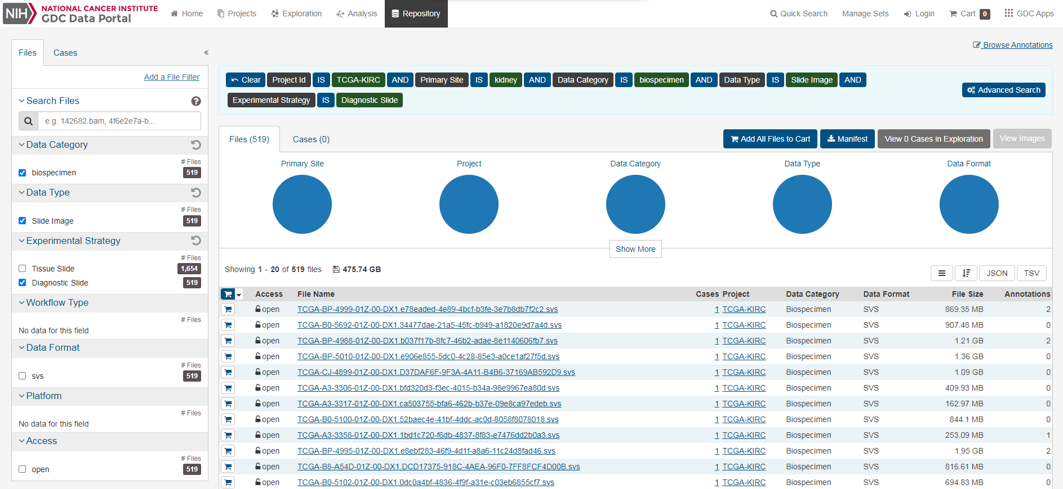
GDC data portal
3
Take TCGA-KIRC for example. Chose kidney in Primary Site and TCGA-KIRC in Project

Slide 8

GDC data portal
4
Click the cart button for each file to add this file into the Cart.

Slide 9
GDC data portal
5
Click the Cart button on the top of the panel

Slide 10
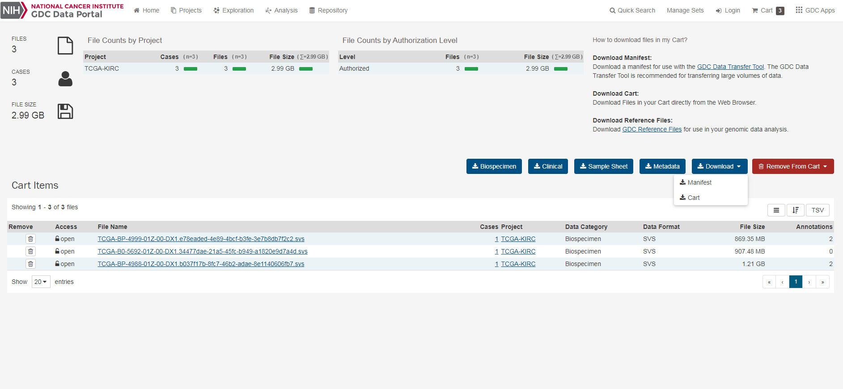
GDC data portal
6
Click the Manifest button to download manifest file into your local side

Slide 11
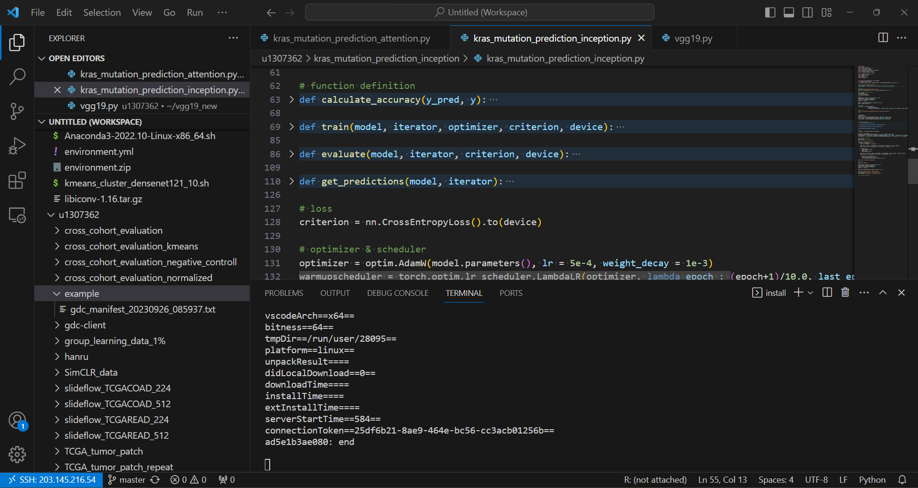
Remote server
7
Upload the manifest file to your remote server

Slide 12
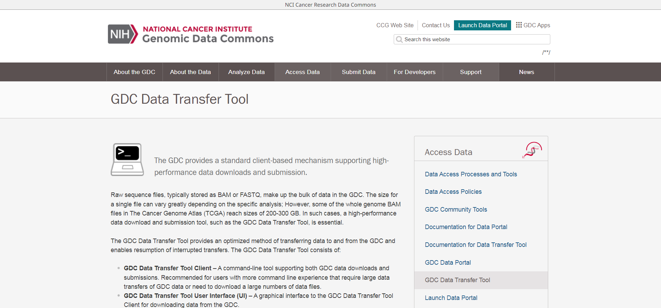
GDC Data Transfer Tool
https://gdc.cancer.gov/access-data/gdc-data-transfer-tool
https://docs.gdc.cancer.gov/Data_Transfer_Tool/Users_Guide/Getting_Started/

Slide 13
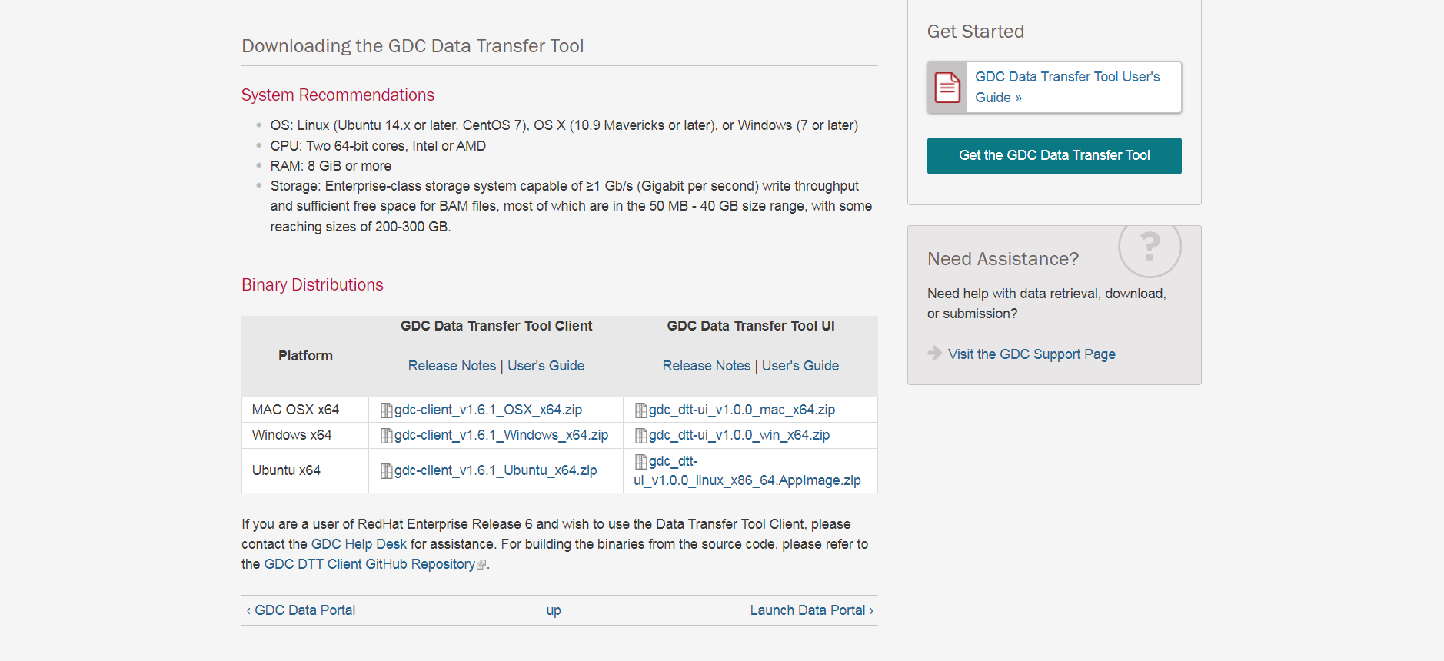
GDC Data Transfer Tool
8
Copy GDC Date Transfer Tool Client of Ubuntu x64 platform .zip file URL

Slide 14
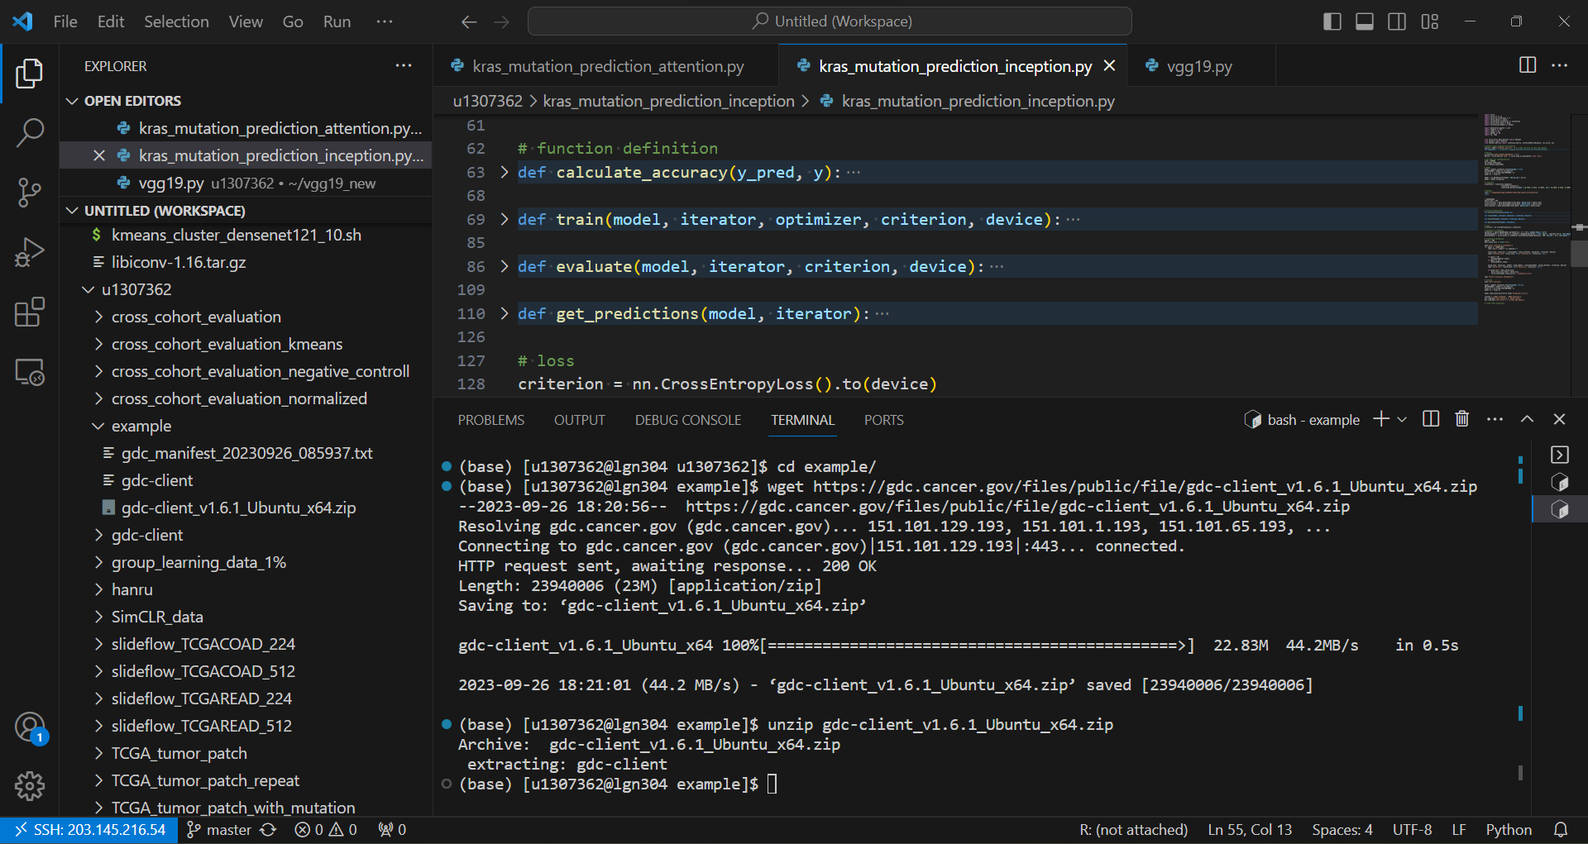
GDC Data Transfer Tool
9
Use wget Linux command to upload GDC Data Transfer Tool .zip file

Slide 15
GDC Data Transfer Tool
10
Use unzip Linux command to install GDC Data Transfer Tool

Slide 16
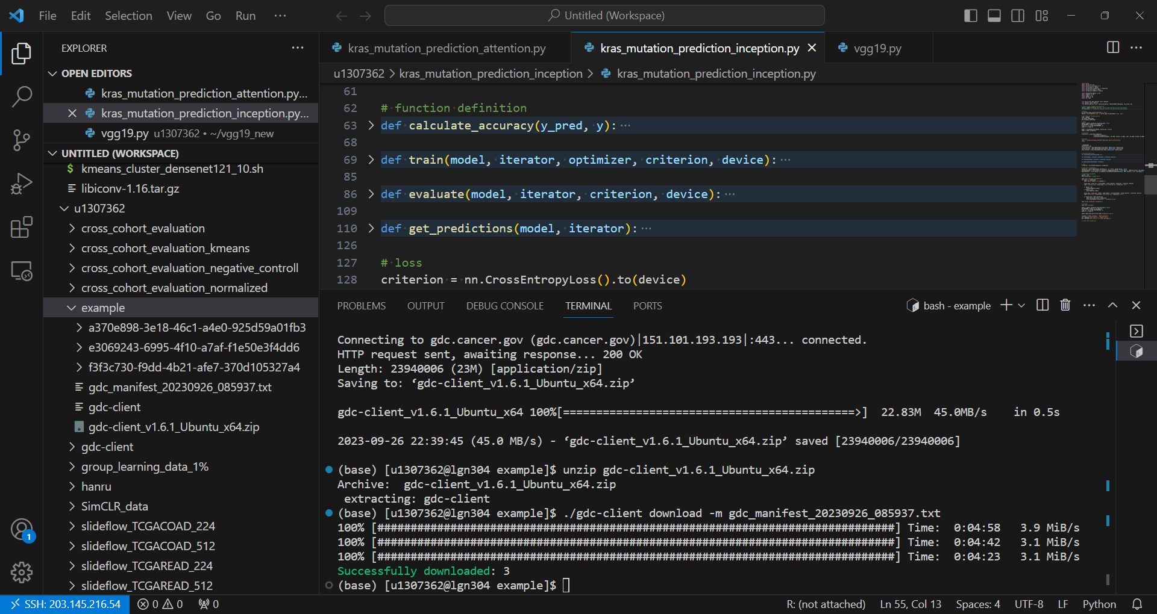
Download WSI
11
./gdc-client download -m gdc_manifest_20230926_085937.txt

